Slide 1
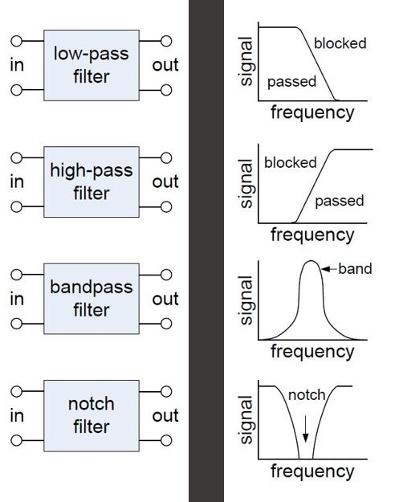
Filtering and Working in the Frequency Domain
Mar-2019

Slide 2
Tonight
Quick Review
2. Look at 38.5kHz PWM filter slides
3. Breadboard/test filter

Slide 3
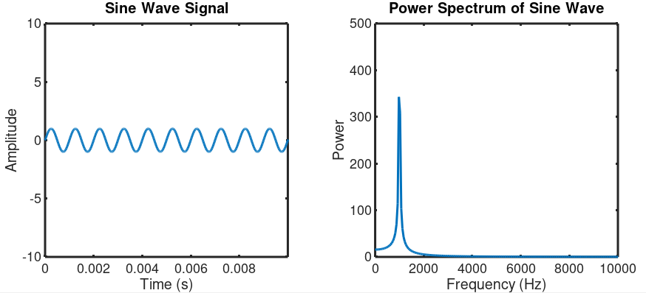
Time vs Frequency Domain
Freq = 1/Period = 1/0.001s = 1000Hz
Period = 0.001s
Frequency = 1 / Period

Slide 4
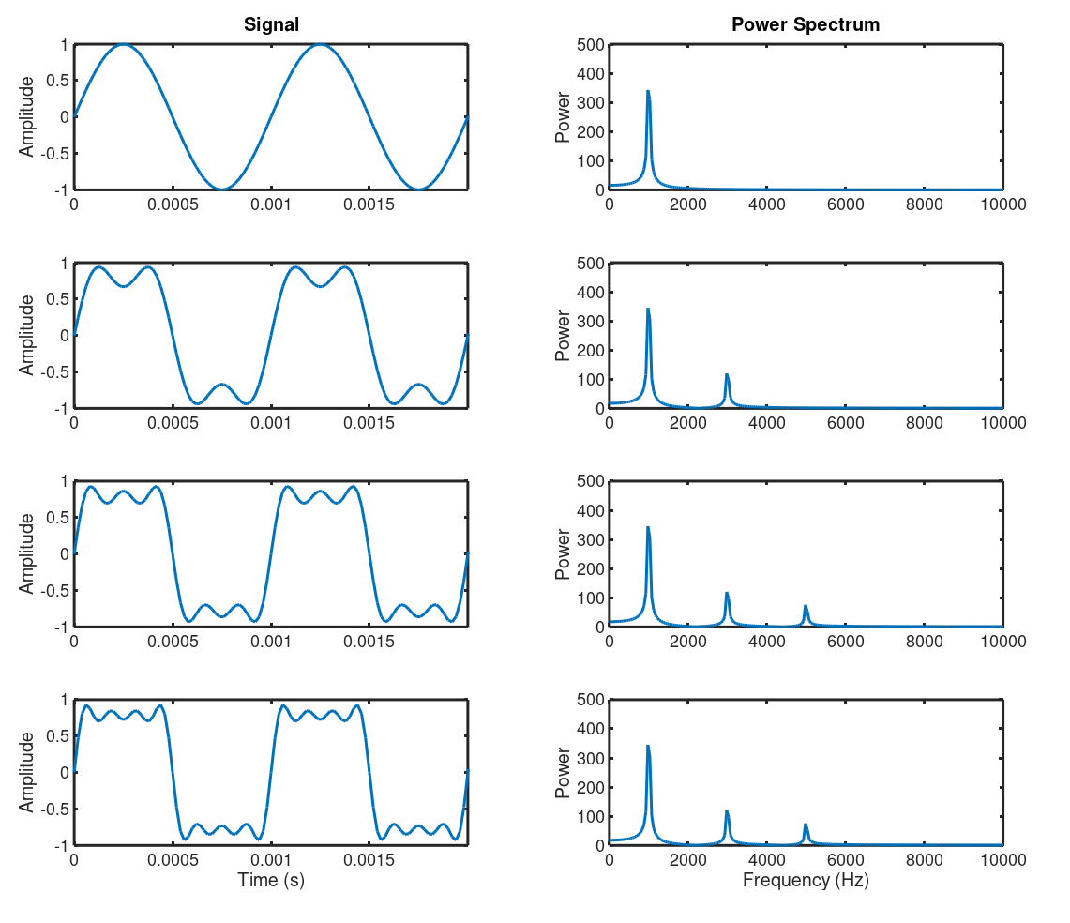
Square Wave = Odd Harmonics

Slide 5
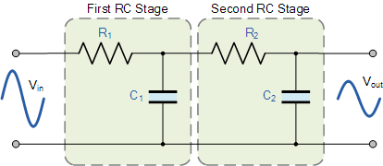
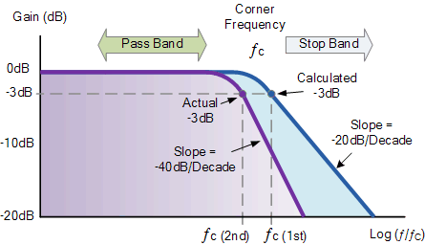
1st and 2nd Order Low Pass Filters

Slide 6
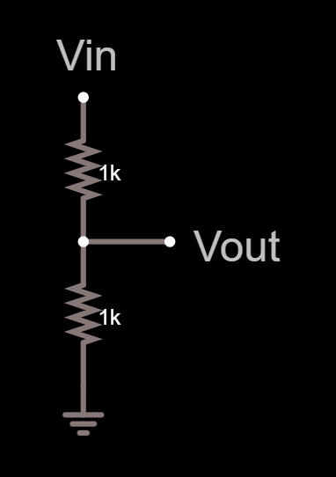
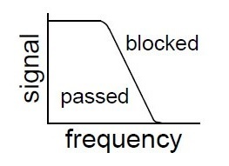
A Conceptual Low Pass Filter
All-pass
Low-pass
Decreases with frequency

Slide 7
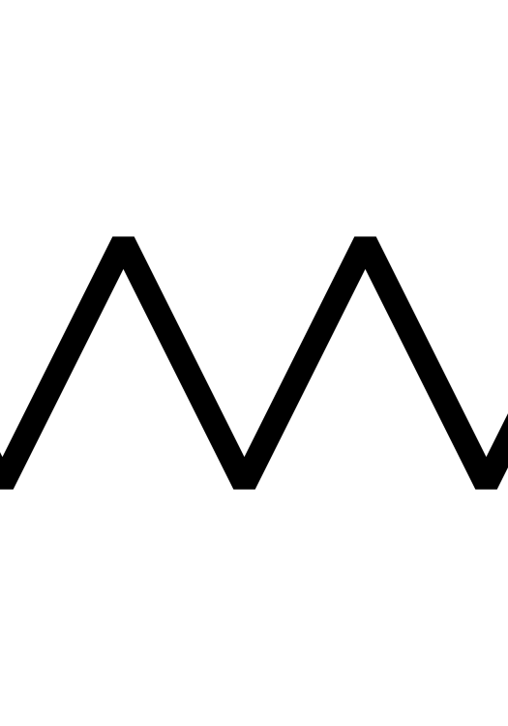
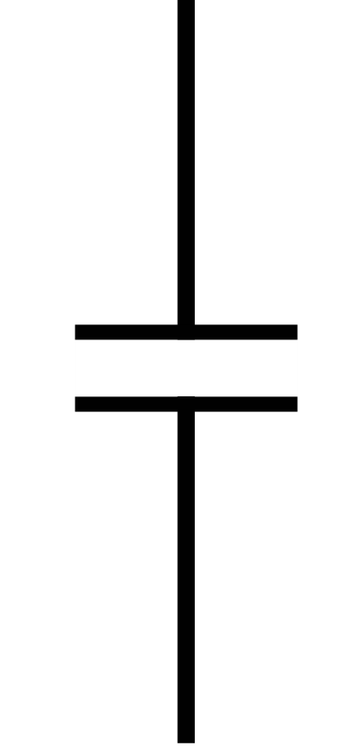
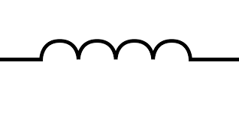


RLC Components vs Frequency
DC Resistance/ AC Reactance
Change w/ freq?
R
$$XC∝ \frac{−1}{fC}$$
$$XL∝fL$$

Slide 8
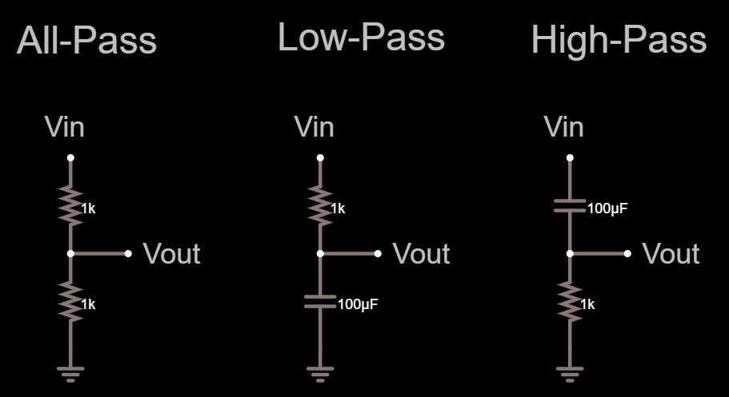
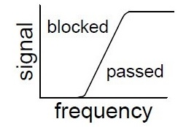
RC Filters
Decreases with frequency

Slide 9
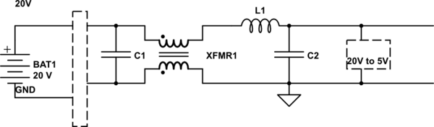
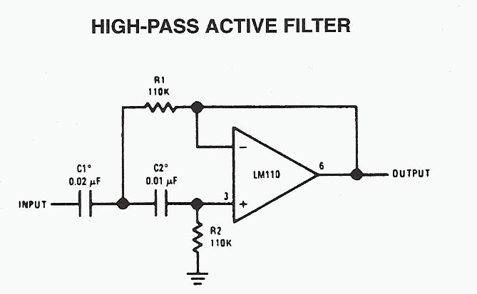
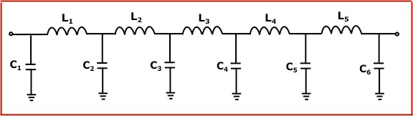
Other filter topologies
Common Mode Choke
2nd order LC filter
2nd order active filter
11th order LC filter

Slide 10
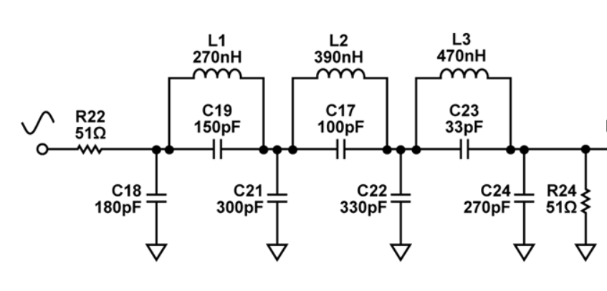
Other filter topologies
7th order elliptical filter
11th order LC filter
2nd order active filter

Slide 11
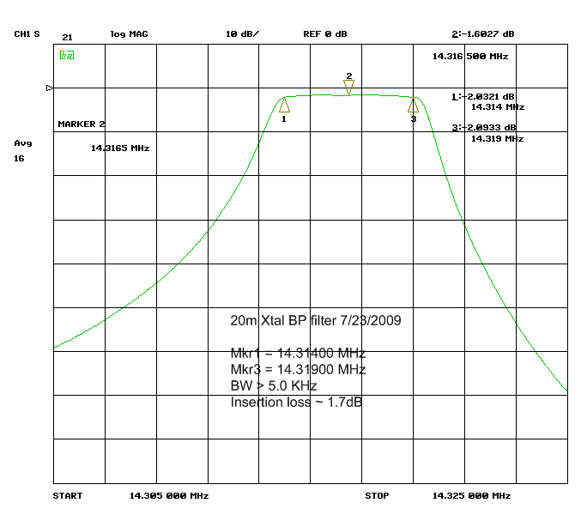
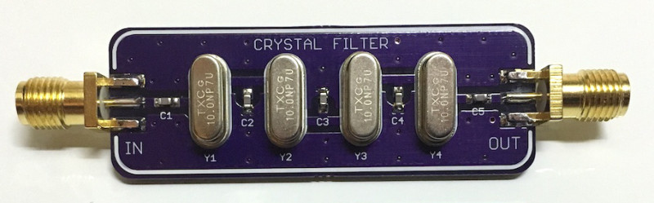
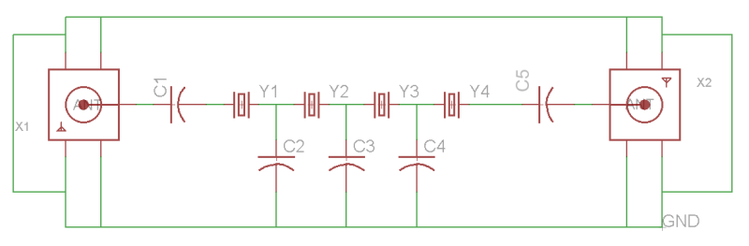
Crystal Bandpass Filters
4 pole crystal filter
https://hackaday.com/2016/03/13/designing-a-crystal-ladder-bandpass-filter/

Slide 12
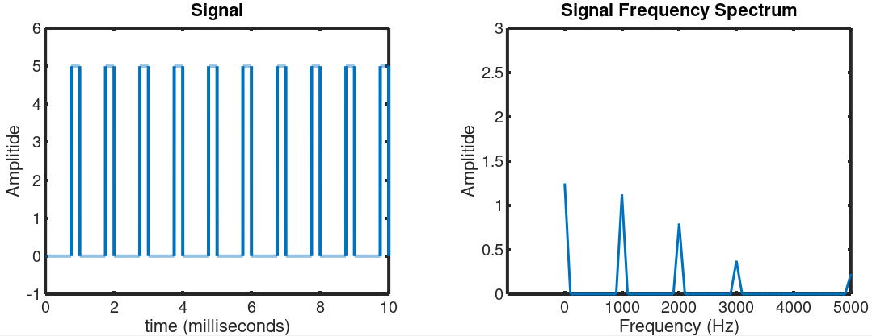
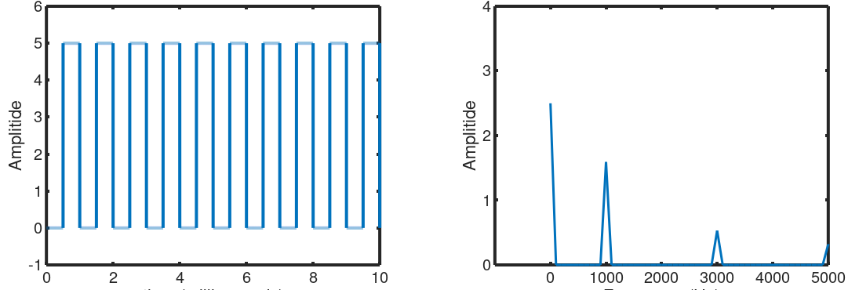
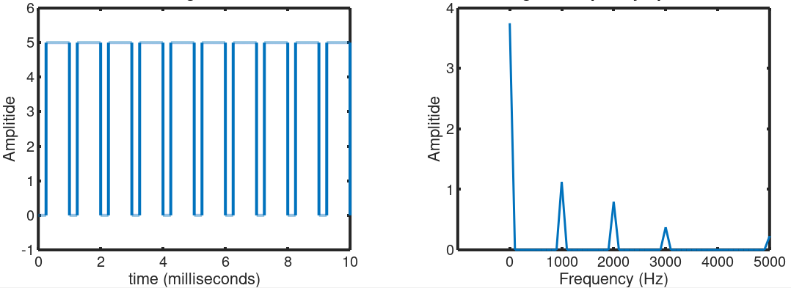
PWM Freq Components
25% Duty Cycle
50% Duty Cycle
75% Duty Cycle

Slide 13
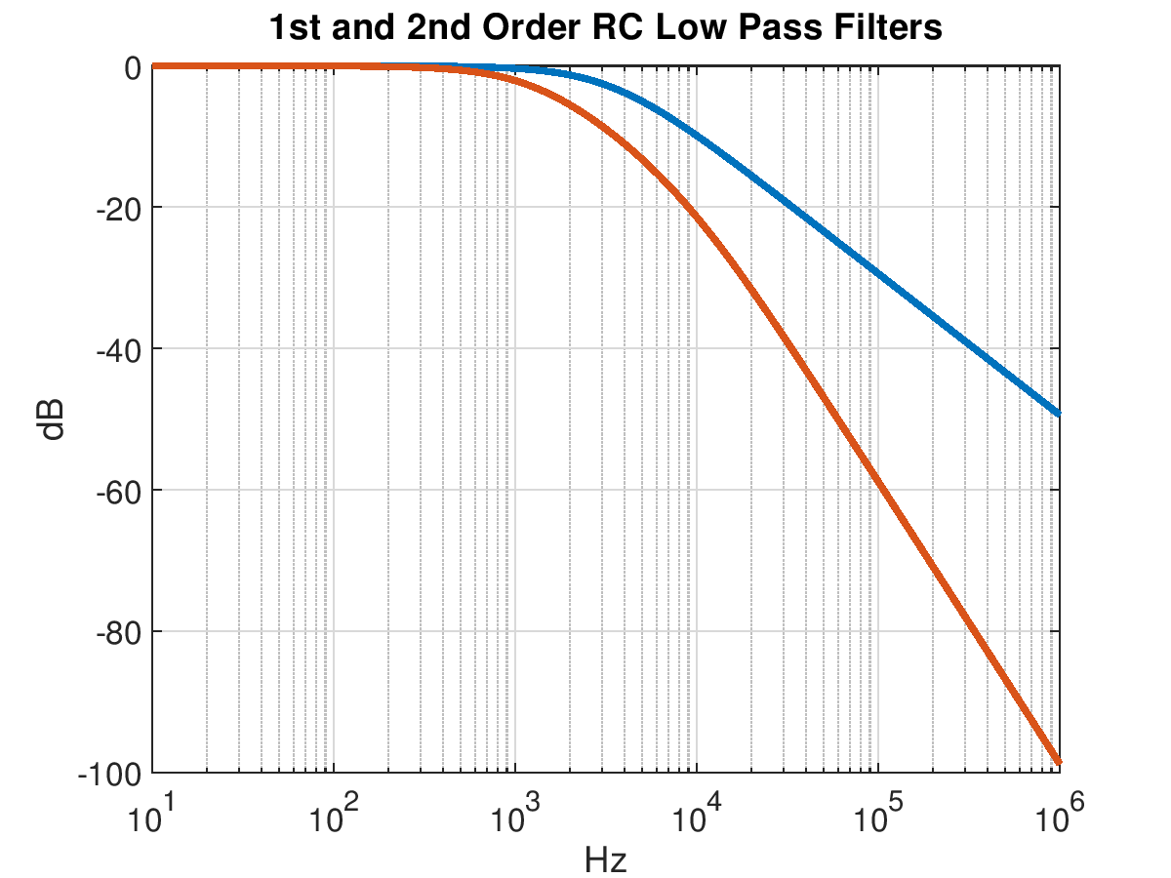
Example PWM Filters
R1 = R2 = 470 Ohms
C1 = C2 = 0.1µF
1st order f_{c} = 1/(2πRC) = 3.39kHz
f_{c}
-20dB=1/10
-40dB=1/10
PWM Freq = 38.5kHz

Slide 14
PWM Signal – 4%, 50%, 98%
7%
50%
98%

Slide 15
PWM Signal – 50%
50% PWM
1st Order Filter
2nd Order Filter

Slide 16
PWM Signal – 4%
4% PWM
1st Order Filter
2nd Order Filter

Slide 17
PWM Transition – 98% to 4%
98% PWM
1st Order Filter
2nd Order Filter

